Slide 1
Week 5 – Final Presentation
Kevin Cox
CST 499: Capstone for Computer Software Technology
Instructor: Amr Elchouemi
April 2, 2022

Slide 2




Table of Contents
Software Requirements Specification (SRS) Document
Unified Model Language (UML) Design Models
Website Design
MySQL Database
PHP Code

Slide 3

SRS Document
Scope:
Create website for students to access course info
Allow students to view course information
Allow students to enroll in courses
Allow Students to disenroll from courses

Slide 4


SRS Document
Functions:
User can register for account
System populates info into MySQL database
System adds user info to enrolled courses
System provides user with currently enrolled courses
System removes user from courses when disenrolling

Slide 5

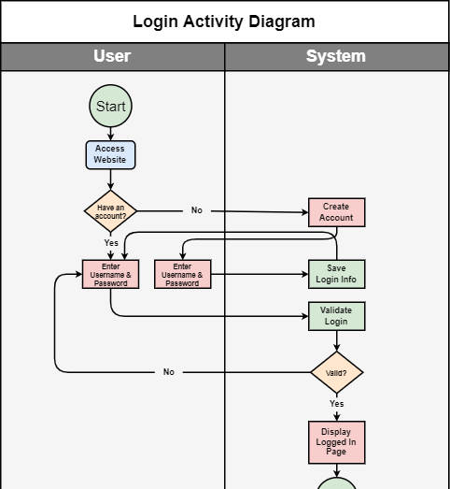
UML Design
Login Activity Diagram
Illustrates interaction between user actions and system actions

Slide 6
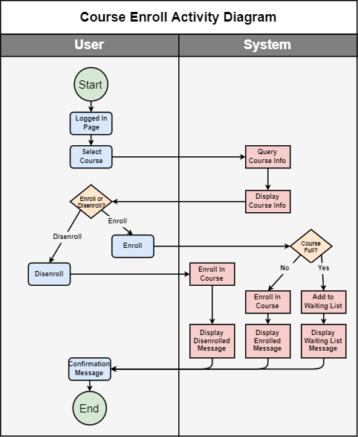
UML Design
Course Enroll Activity Diagram
Illustrates interaction between user actions and system actions

Slide 7
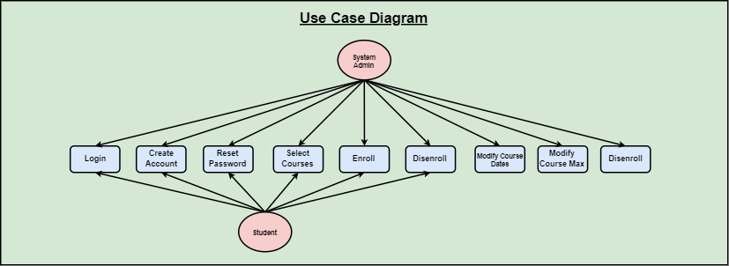
UML Design
Use Case Diagram
Illustrates which roles are allowed to perform which tasks

Slide 8
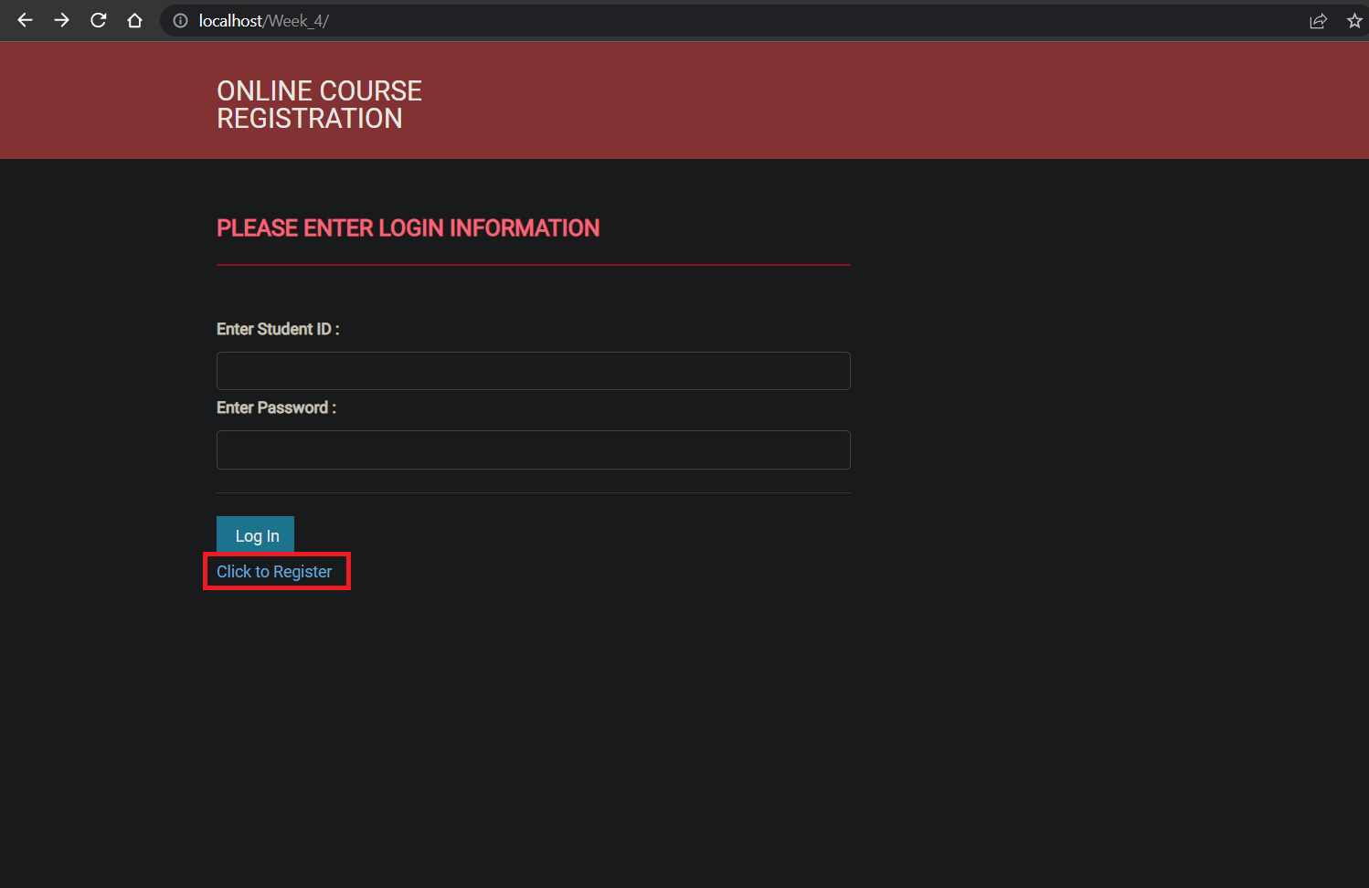
Website Design
Main Login Page with Register Link

Slide 9
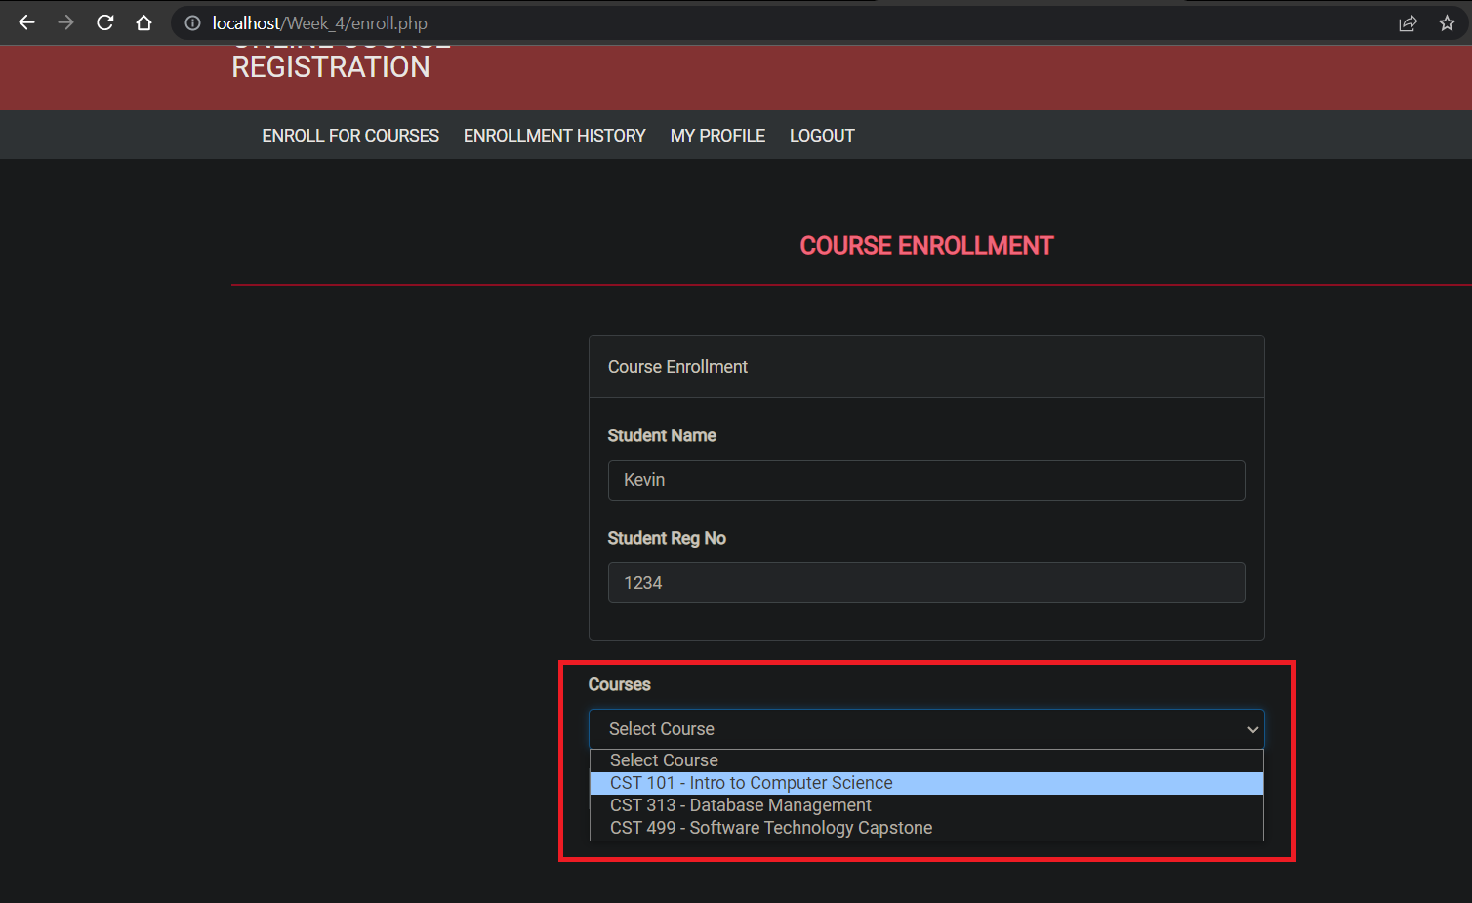
Website Design
Course Enrollment Page

Slide 10
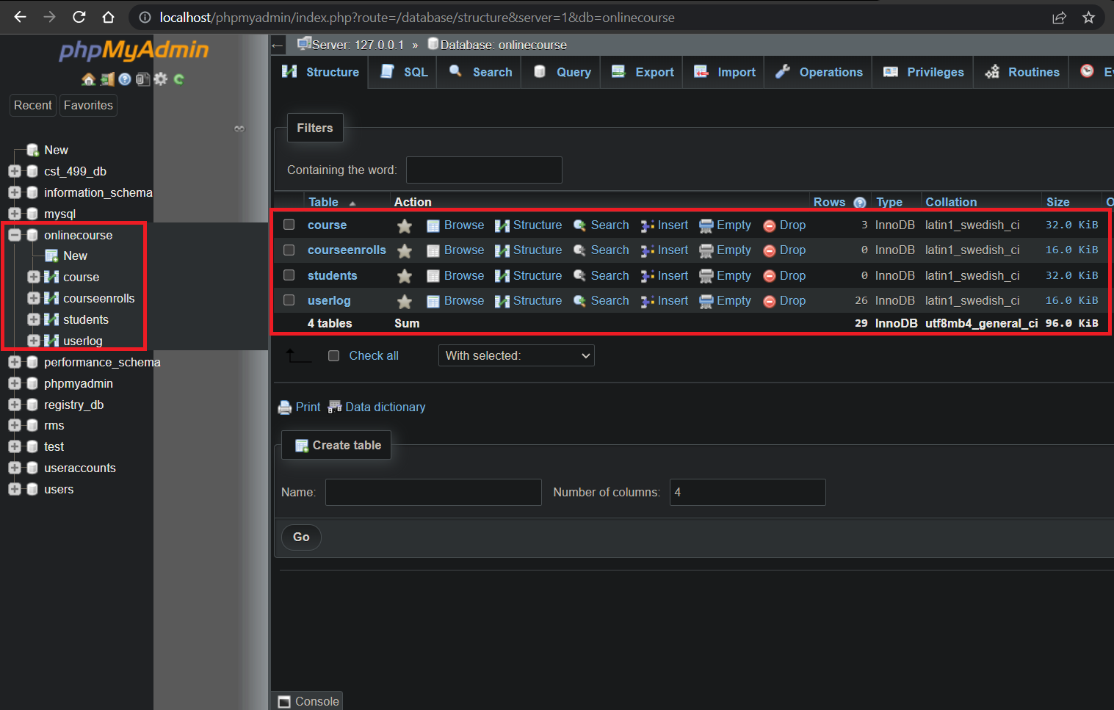
MySQL Design
MySQL Database with Tables

Slide 11
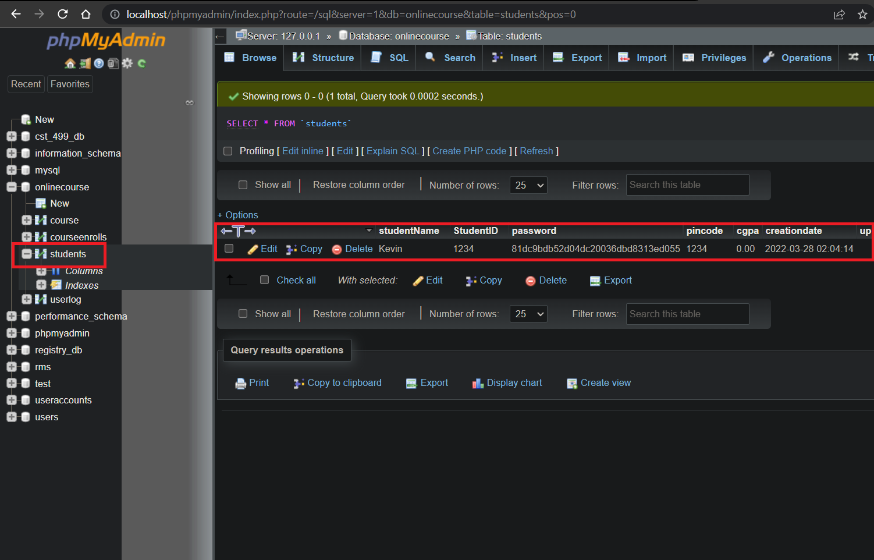
MySQL Design
Student Table in MySQL Database

Slide 12
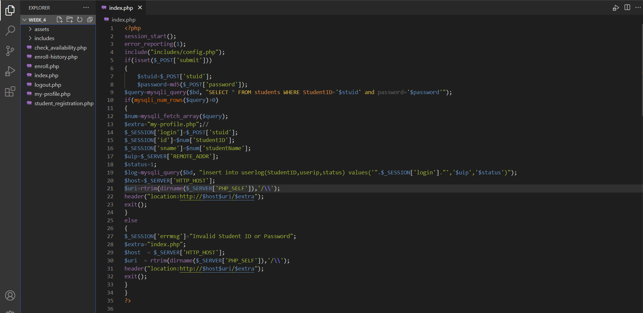
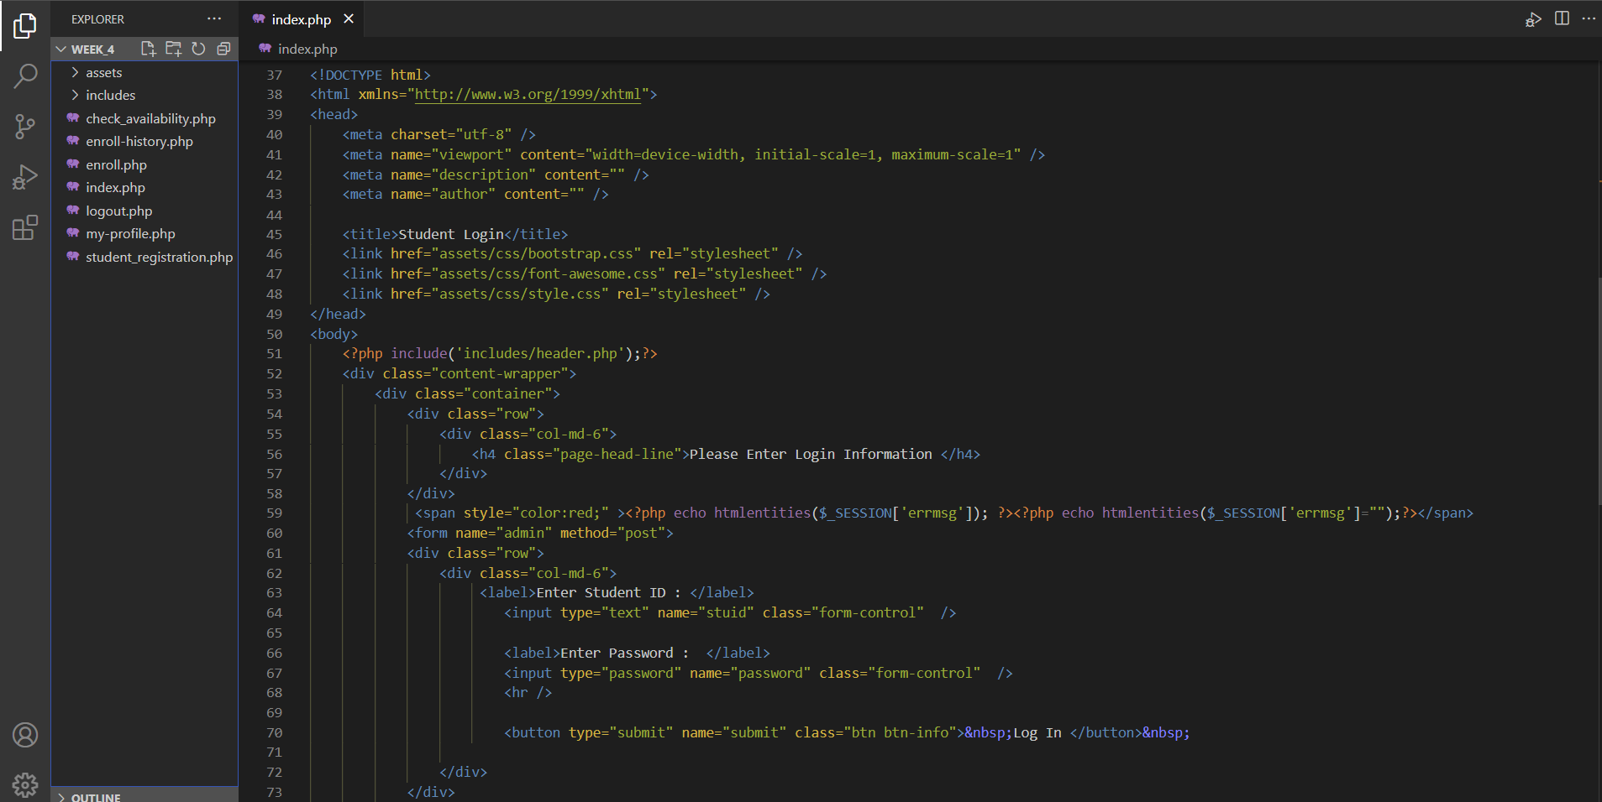
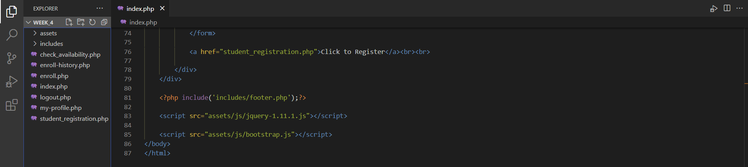
PHP Design
“index.php” Source Code
This PHP file is the source code for the main login page
Includes Username and Password input blocks
Also incorporates the “student_registration.php” file link

Slide 13
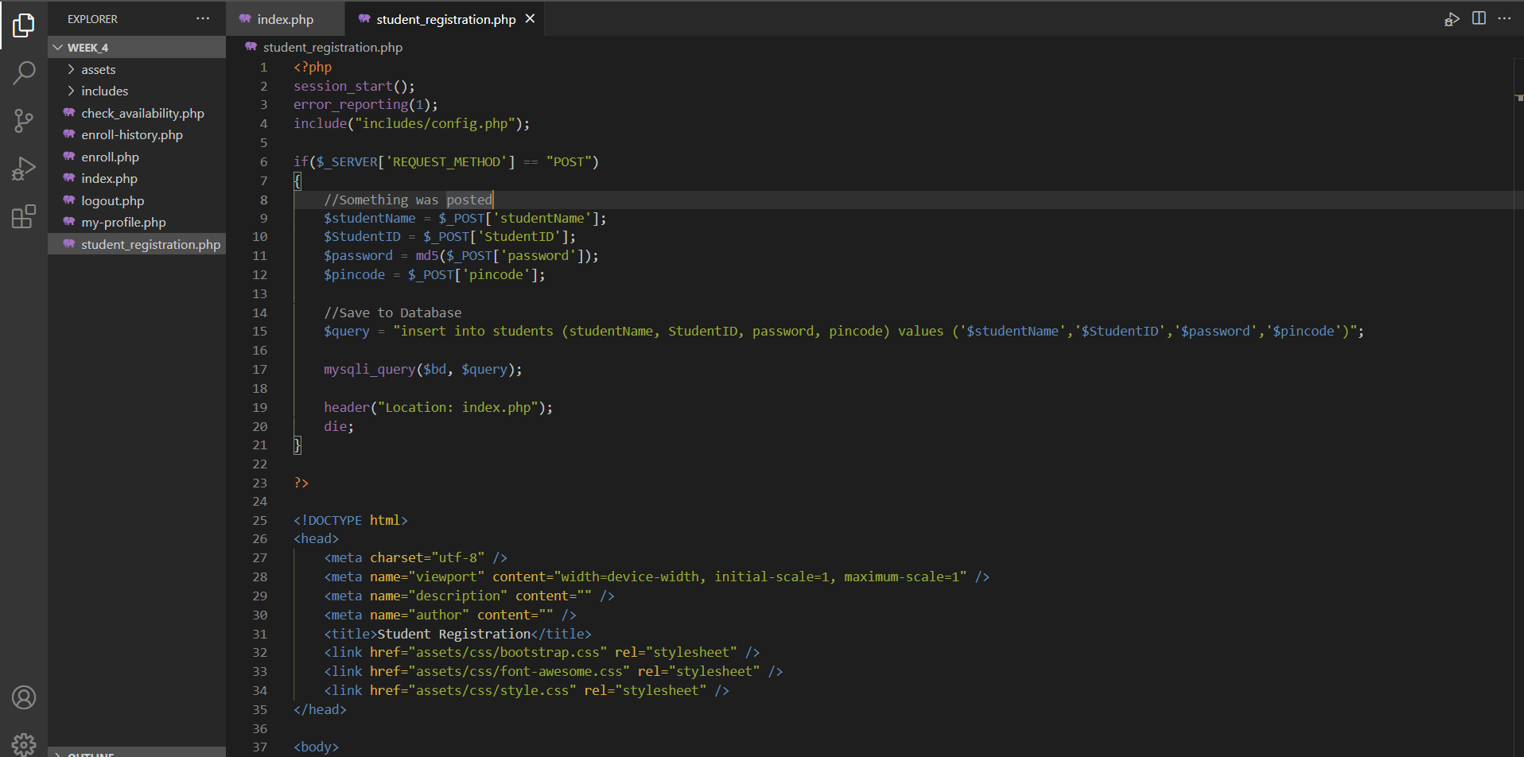
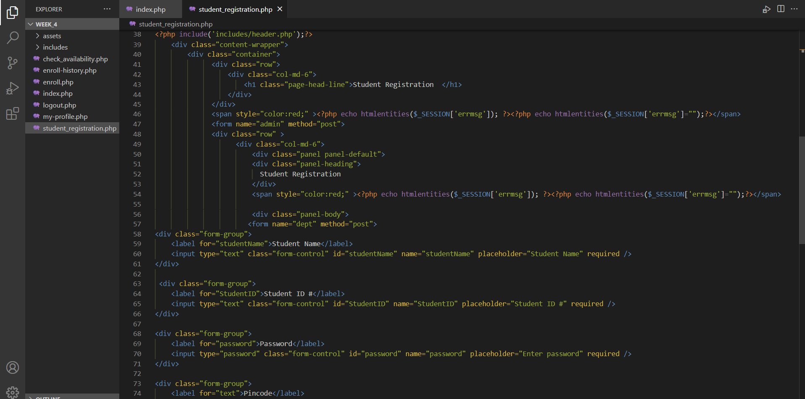
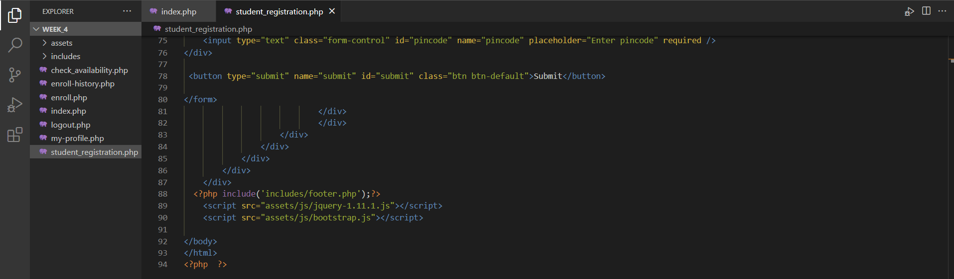
PHP Design
“student_registration.php” Source Code
This PHP file is the source code for the student registration page
Creates input blocks for students to enter their unique information
Submits Student Name, Student ID, Password, and Pin code information to MySQL Database

